Slide 1


Team 25-MSAMI
■Project
: Android App for HanYang University Student
■Team Member
Park Jae Yong
Kim Min Sang
Kim Dong Gyu

Slide 2

Contents
Member Introduce
App Introduce
Product and Result
Our Task(Delvelope & Problem)
Reference & License

Slide 3

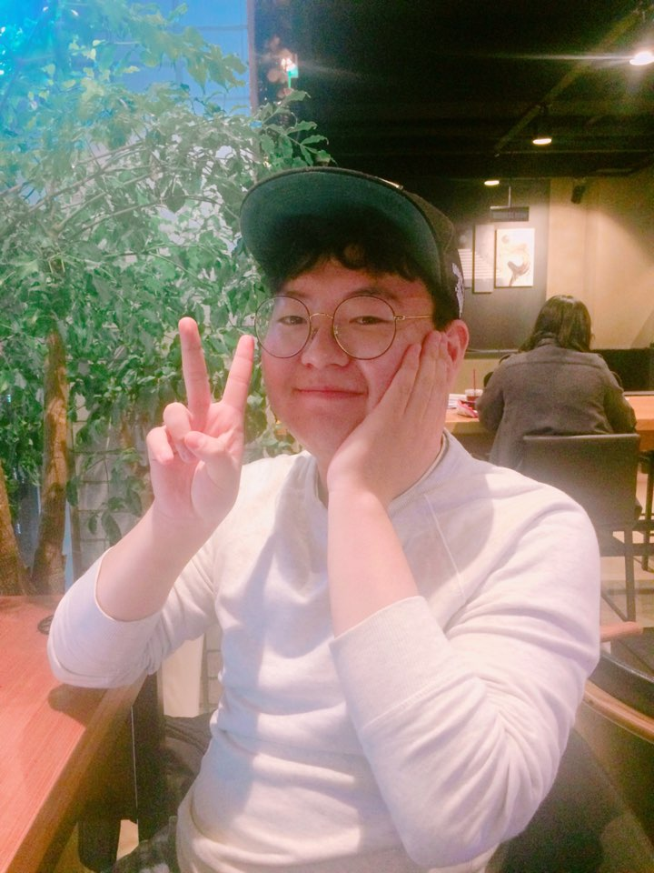

Member Introduce
Park Jae Yong
Kim Dong Gyu
Kim Min Sang

Slide 4



Already....
But!!!

Slide 5



What App We Want To Make?
Comfortable!!!!!

Slide 6
Product and Result

Slide 7
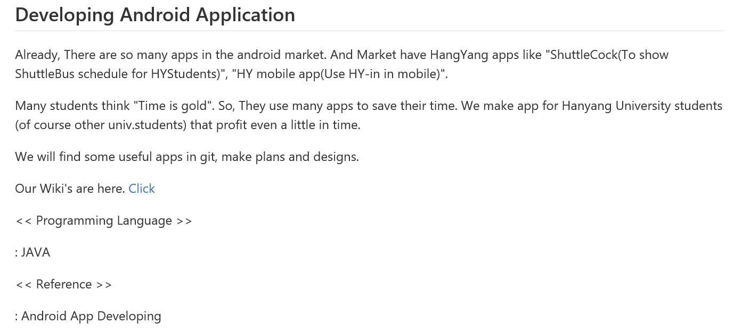
Outline

Slide 8
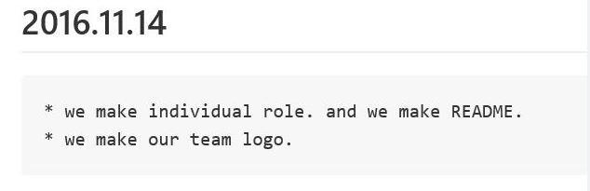
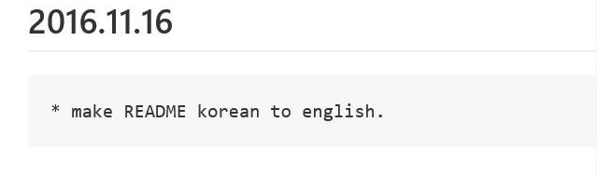
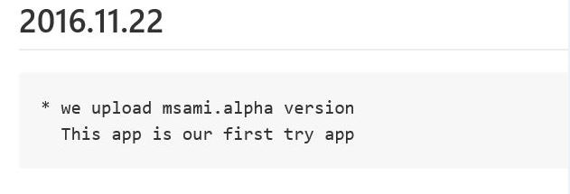
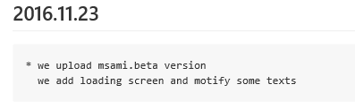
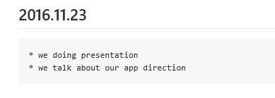
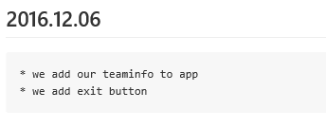
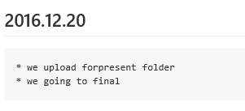
What We Have Done?
⊙Make Individual Role
⊙Make Outline
⊙Develop!
⊙Upload alpha version
⊙Make beta version
⊙Make Final version!

Slide 9
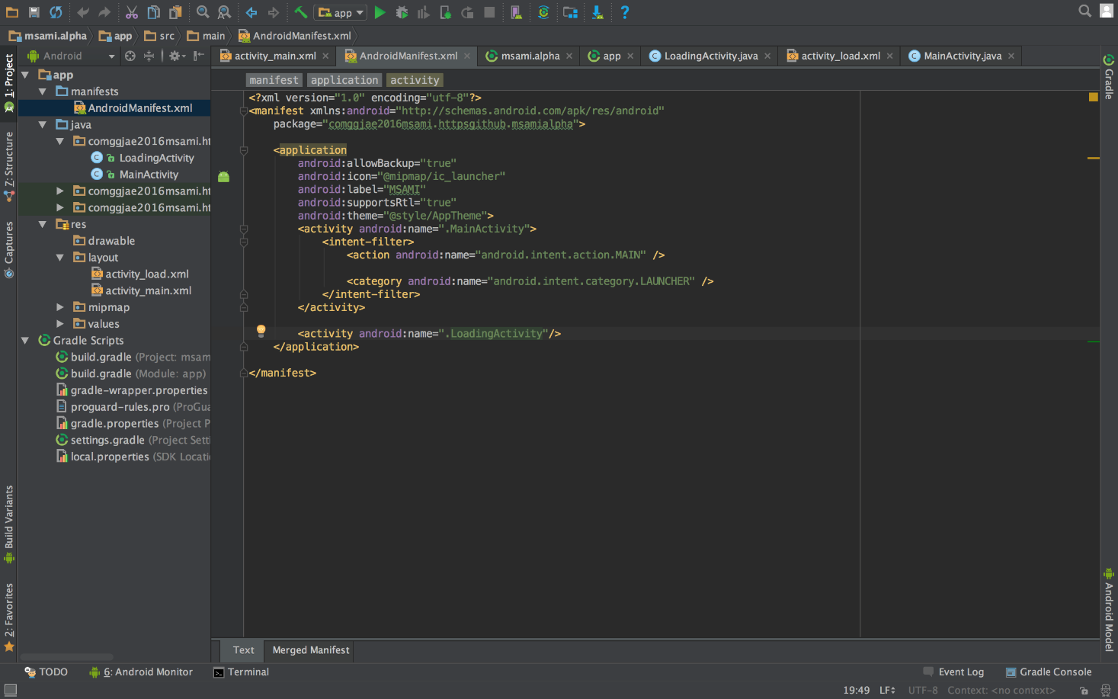
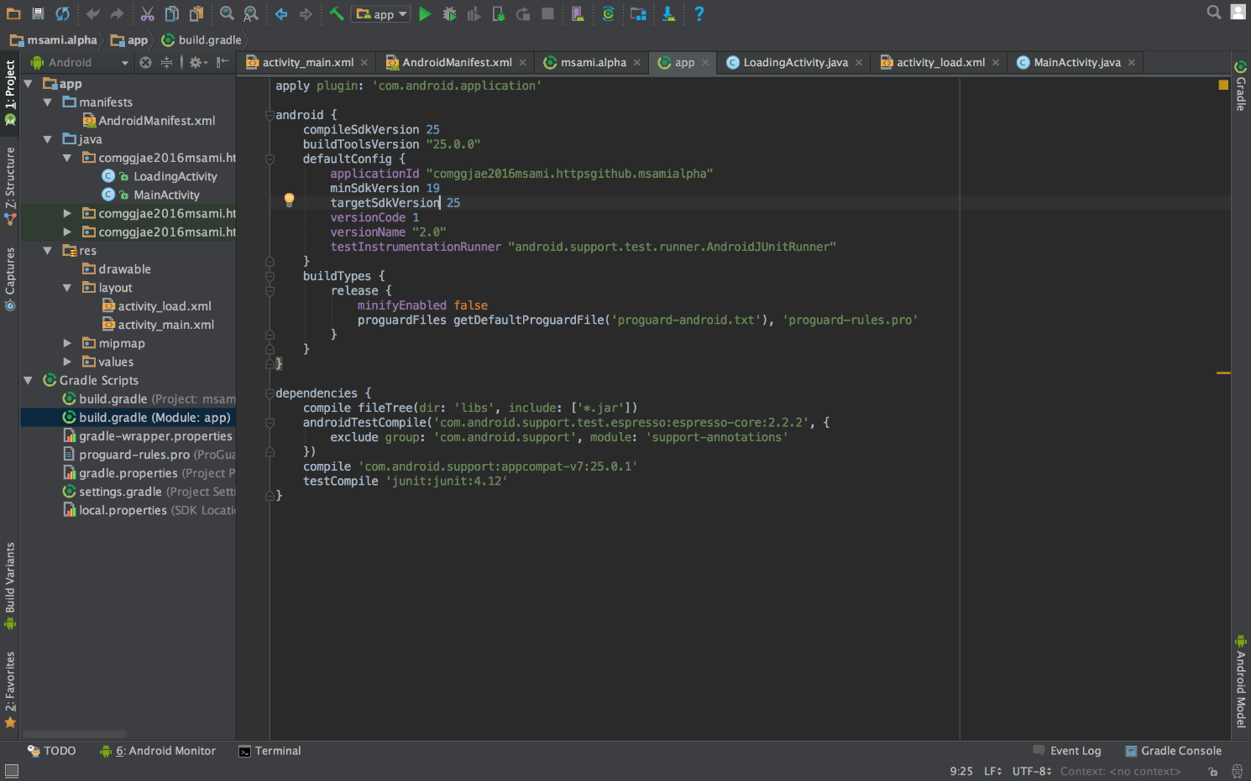
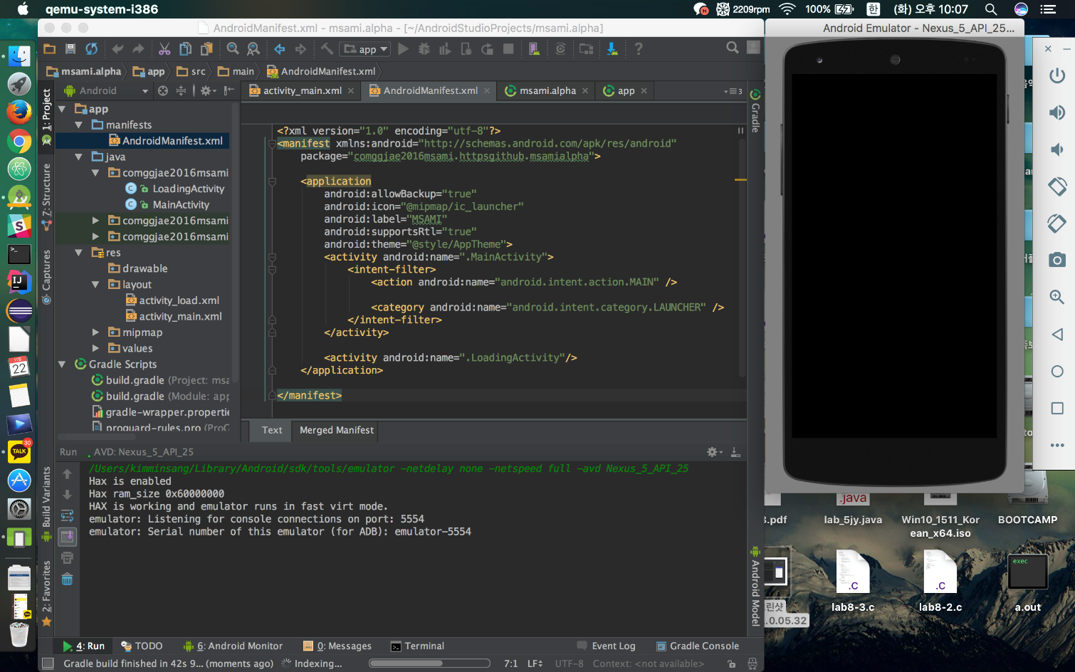
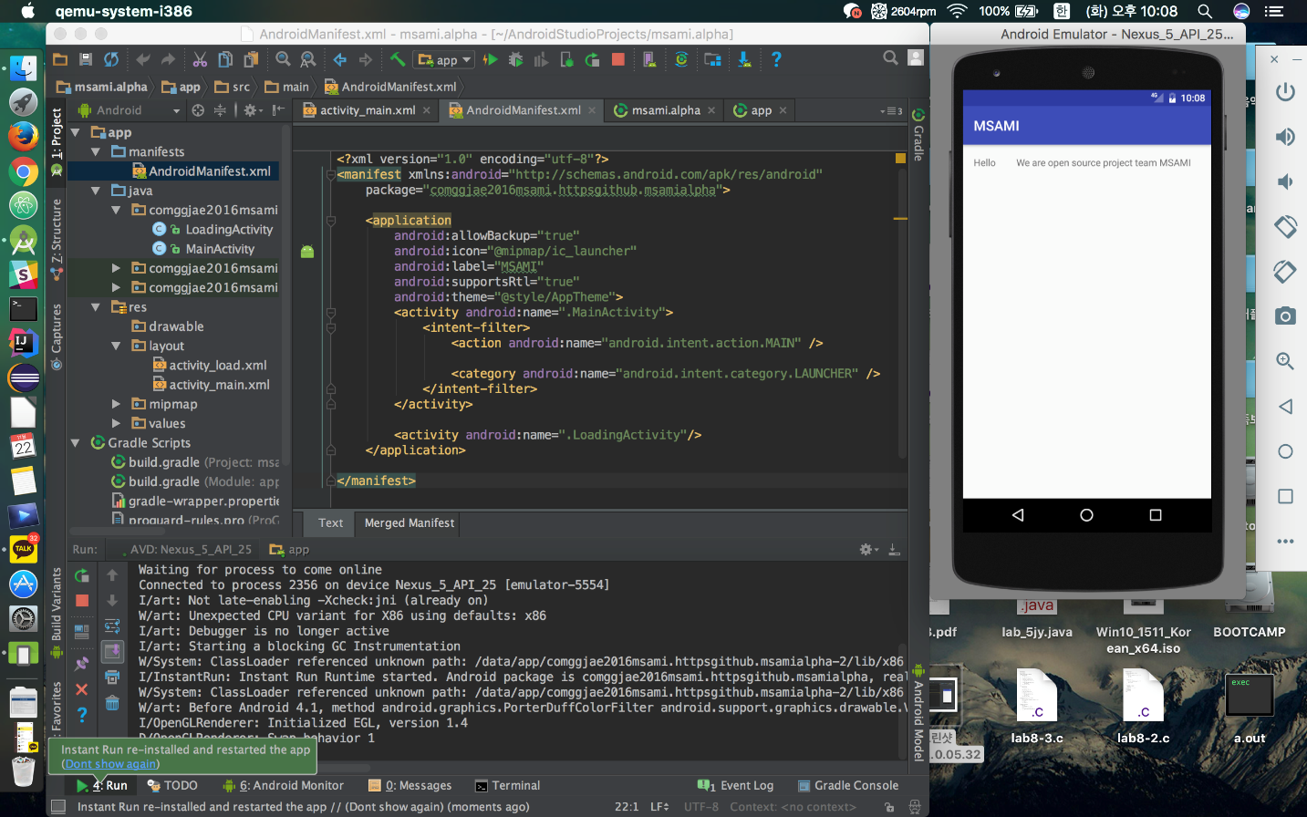
Develop Process

Slide 10
Problem
- Error Modify

Slide 11

Result!

Slide 12
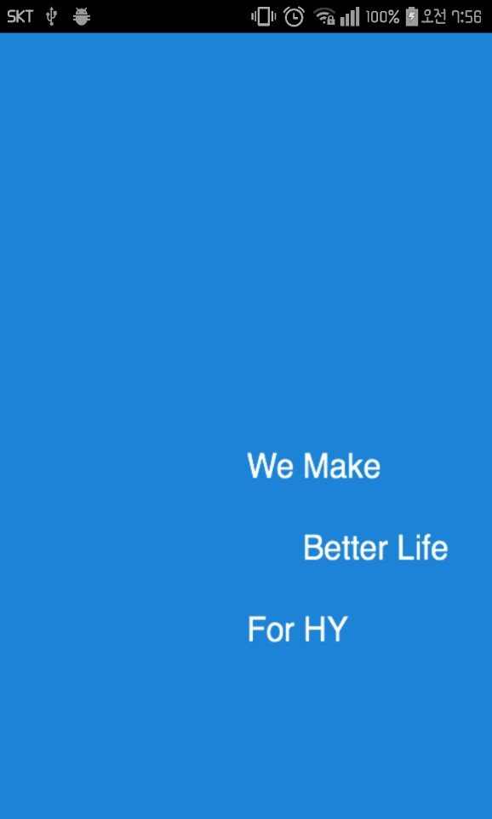
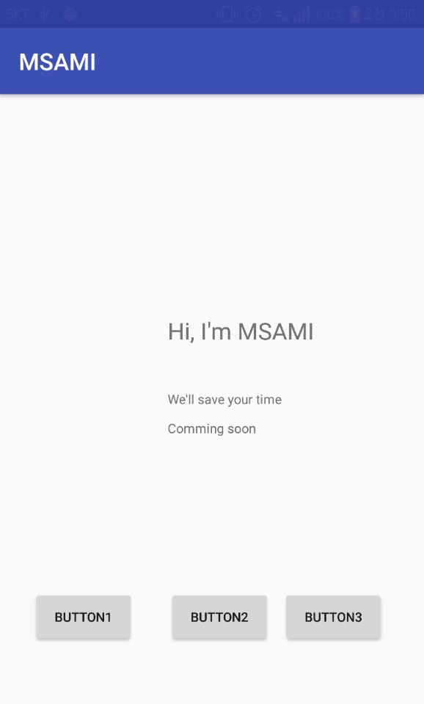
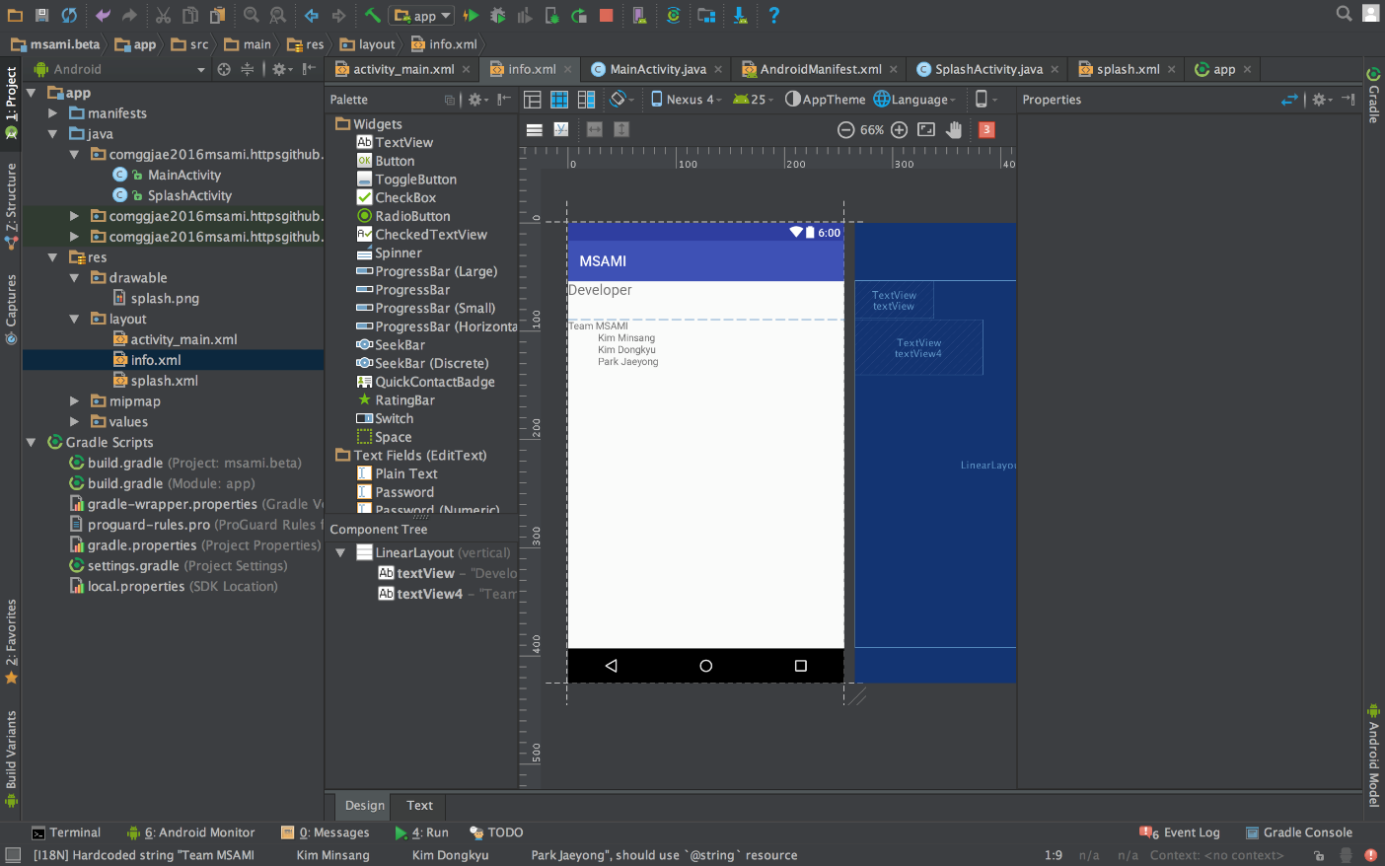
Mid-Result!

Slide 13
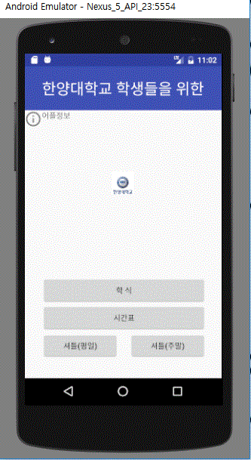
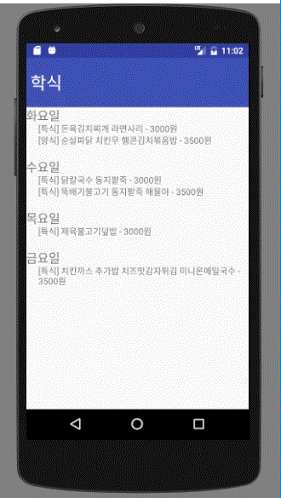
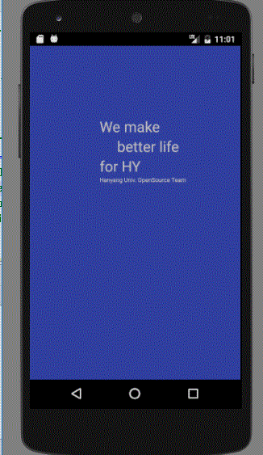
Final-Result!

Slide 14
Reference & License
Reference(lecture)
http://m.blog.naver.com/eominsuk55
License
- Apache 2.0

Slide 15
Thanks for watching! ☺

